Slide 1
My experience and thoughts about my training course.
IHO – NIPPON FOUNDATION
ALUMNI SEMINAR
Lt.Jr. G (Navy) Laura Paolino de Souza
URUGUAY
Alumnae of 6th Training Course in Hydrography Data Processing and Marine Cartography

Slide 2
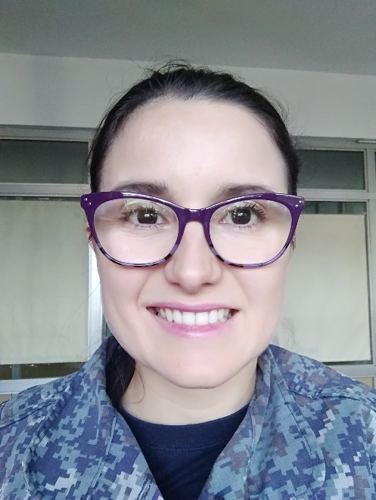
Self introduction
IHO – NIPPON FOUNDATION
ALUMNI SEMINAR
Name | LAURA PAOLINO de SOUZA
Alumni year | 2014
Country | URUGUAY
Organization | SOHMA, URUGUAYAN NAVY
Position/Job title | Lt. Jr. G. (Navy) HEAD OF CARTOGRAPHIC PRODUCTION
Current job description | MANAGEMENT OF PAPER CHARTS AND ENC PRODUCTION (Planning and Quality control)
Please put your photo here!

Slide 3
My career path and projects / Achievements
IHO – NIPPON FOUNDATION
ALUMNI SEMINAR
2012: I joined the Hydrographic Office.
2014: I attended the 6th Training Course in Hydrography Data Processing and Marine Cartography, UKHO (CHART Project)
2015 (March): I got my new post as Head of Cartographic Production.
Other training: ENC Validation, Software workshops, Technical Conferences.
Achievements: Migration from GIS into S-57; Compilation of New Editions of Paper Charts under the INT Format (50%); matching compilation processes between ENCs and Paper charts (timelines and amount); stable growth of our ENC folio adding specific ENCs in restricted waters or channels.

Slide 4
Lessons learned from CHART Course
IHO – NIPPON FOUNDATION
ALUMNI SEMINAR
The training is the “point zero” of your professional path.
Trust: in myself, from my bosses, in my team.
Continuous learning: new opportunities every year related my capacitation on Marine Cartography.
Permanent networking with colleagues from all over the world.

Slide 5
Suggestion for the future
IHO – NIPPON FOUNDATION
ALUMNI SEMINAR
My advice for the new generations:
Be aware of the changes and be prepared for them.
Lean on your people, you are a team.
Don´t forget you´re not alone and you´ve excellent colleagues.
Grab always the chance to learn a bit more.
My suggestions for IHO and NF:
Please carry on giving these wonderful opportunities to all of us especially to the young people.

Slide 6
IHO – NIPPON FOUNDATION
ALUMNI SEMINAR
Any questions?
Thanks to all for your attention!!!
sohma@armada.mil.uy
sohma_carto_jefe@armada.mil.uy

